Slide 1

PVSio-web
Design and development of an arcade simulation environment for PVSio-web
MSc in Computer Science
José Carlos Brandão (a71223)
Escola de Engenharia
Departamento de Informática
Universidade do Minho

Slide 2
MSc Pre-dissertation Workshop
2D Arcade Racing Game
Jul 21st, 2018
Advisor: José Creissac Campos
Co-Advisor: Paolo Masci

Slide 3
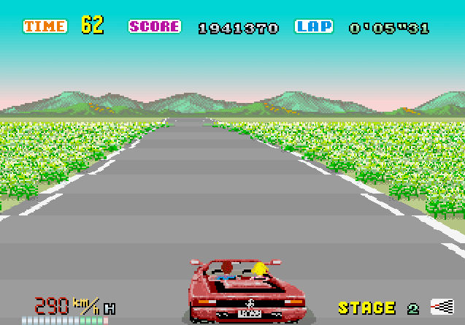
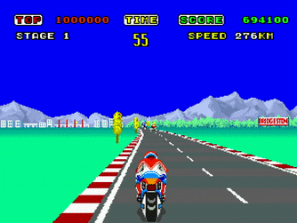
José Carlos Brandão (a71223@alunos.uminho.pt)
MSc Pre-dissertation in Computer Science PVSio-web
Examples of Old Arcade Racing Games
3
Source: https://medium.com/@morgankitten/looking-back-at-outrun-aa8504c5da68
Source: https://gfycat.com/gifs/detail/quickdeadlygordonsetter

Slide 4
José Carlos Brandão (a71223@alunos.uminho.pt)
MSc Pre-dissertation in Computer Science PVSio-web
Agenda
4
1
2
3
State of the Art
Problems & Challenges
Proposed Solution
Prototyping
Environments Prototyping
Rapid Prototyping
Design Flaws
Better Quality Products
Detect design flaws
Achieve better designs
Automotive Area
Car Dashboards
Environment Prototyping achieved with 2D arcade racing game (track with slope, curves, grass, billboards, moving obstacles, etc)
External Controllers Integration (PS4 controller and USB steering wheel)

Slide 5
José Carlos Brandão (a71223@alunos.uminho.pt)
MSc Pre-dissertation in Computer Science PVSio-web
State of the Art
SECTION 1
SECTION 2
SECTION 3
5
“USER INTERFACE prototype - Functional, computer-based simulation of the USER INTERFACE that enables representative USERS to perform realistic tasks “
“Computerized prototypes are especially valuable for testing alternative USER INTERFACE designs prior to the production of operational models.”
“The faster that a prototype can be created and modified, the more likely it is that USER test results have a real impact on the product’s design. “
“It is useful to employ software tools that facilitate rapid prototyping to allow changes at low cost.“
Cited in: BS EN 62366:2008 — ICS 11.040.01
BRITISH STANDARD — Medical devices
Application of usability engineering to medical devices
Toolkit: PVSio-web (http://www.pvsioweb.org)
Notes:
“MEDICAL DEVICE prototype - A near-final, working version of the MEDICAL DEVICE that can be used for its INTENDED USE”

Slide 6
José Carlos Brandão (a71223@alunos.uminho.pt)
MSc Pre-dissertation in Computer Science PVSio-web
Problems & Challenges
SECTION 1
SECTION 2
SECTION 3
6
Interactive Systems Problems – 2015 Lincoln MKC design flaw
2D Prototypes (Low Fidelity) vs 3D Prototypes (High Fidelity)
Faster (runs on any browser/device)
Less resources (i.e. smaller libraries)
3D visual aspects can be achieved
Smaller and more readable code
Cheaper
Main Goal – Prototype “Having someone driving in a road, with obstacles.”
Notes:
Goal is to have something – prototype of having someone driving in a road
Performance problem – high fidelity platforms vs outrun
Problem with interactive systems
Redo all from the example autopark

Slide 7
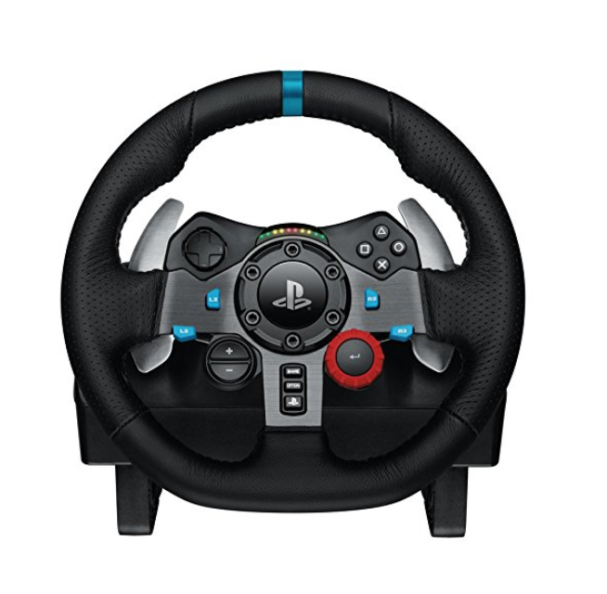
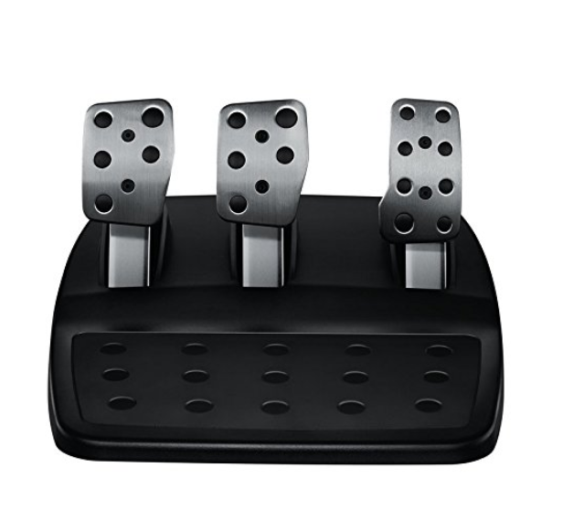
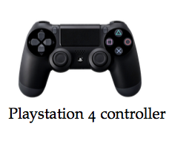
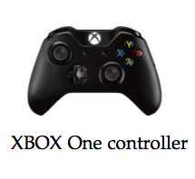
José Carlos Brandão (a71223@alunos.uminho.pt)
MSc Pre-dissertation in Computer Science PVSio-web
Proposed Solution
SECTION 1
SECTION 2
SECTION 3
7
Development of APIs
Concrete Application by developing a 2D Arcade Driving Simulator
Creation of a Track
Setup Vehicle
Setup Landscape/Surroundings
Integration of External Controllers
Integration of Gyroscope Controllers
PS4 Controller
XBOX One Controller
Logitech G29 – Steering Wheel and Pedals
Source: PVSio-web (https://github.com/zecarlos94/pvsio-web/blob/gaming/)

Slide 8
Implementation

Slide 9
José Carlos Brandão (a71223@alunos.uminho.pt)
MSc Pre-dissertation in Computer Science PVSio-web
How To Achieve 3D Perspective In A 2D Game
9
fov/2
Source: https://codeincomplete.com/posts/javascript-racer-v1-straight/
Notes:
h = camera height
d = distance from camera to screen = 1/tan(fov/2), fov(field of view angle - zoom) - projecting onto a normalized projection plane, with coordinates from -1 to +1 and centre(0,0)
z = distance from camera to car
y = screen y coordinate (2D screen) = h*d/z (side-on view)
x = w*d/z, w = ½ * width of the road (from camera to road edge) (top-down view)
The translate equations calculate the point relative to the camera
The project equations projects camera coordinates onto a normalized projection plane
The scale equations take into account the difference between:
math - where 0,0 is at the center and the y axis goes up
computers - where 0,0 is at the top-left and the y axis goes down.
################################################################################################################################################################
let render = {
width: 320,
height: 240,
depthOfField: 150,
camera_distance: 30,
camera_height: 100
};
context = canvas.getContext('2d');
canvas.height = render.height;
canvas.width = render.width;

Slide 10
José Carlos Brandão (a71223@alunos.uminho.pt)
MSc Pre-dissertation in Computer Science PVSio-web
Developed widgets within PVSio-web
10
Arcade
ArcadeWithoutLaps
TrackGenerator
Customization
Sound
GyroscopeController
GamepadController
VirtualKeypadController
DrawGamepad
SteeringWheel
ButtonExternalController
LincolnMKCDashboard
Notes:
ArcadeWithoutLaps is a copy of Arcade, however everything related to multiple laps was removed
ButtonExternalController is a copy of Button, however has been modified in order to allow the development of DrawGamepad (gamepad virtual controllers- PS4 and XBOX One)

Slide 11
José Carlos Brandão (a71223@alunos.uminho.pt)
MSc Pre-dissertation in Computer Science PVSio-web
How do widgets relate within PVSio-web
11
TrackGenerator
Arcade
Sound
Creates desired track and creates new JSON file with all necessary configurations
Arcade Constructor invokes Sound Constructor (Simulator Audios)
SteeringWheel
Customization
Speedometer
File-Writing API does not yet exist!! TODO
Must return filename just created
Tachometer
DrawGamepad
GyroscopeController
VirtualKeypadController
GamepadController

Slide 12
José Carlos Brandão (a71223@alunos.uminho.pt)
MSc Pre-dissertation in Computer Science PVSio-web
How do widgets relate – Demo ‘old_appearance_ track_generator_Simulator’
12
TrackGenerator
File-Writing API does not yet exist!! TODO
Must return filename just created
Index.js (Demo)
Invoke desired API
API’s to create the track:
1. generateStraightTrack();
2. generateTrackCurvesSlopes();
3. generateTrackBasedOnTrackLayoutOptField();
Methods 1. and 2. generate randomly a new track.
Method 3 generate a new track, based on trackLayout provided
Creates desired track and creates new JSON file with all necessary configurations

Slide 13
José Carlos Brandão (a71223@alunos.uminho.pt)
MSc Pre-dissertation in Computer Science PVSio-web
How do widgets relate – Demo 1 (old_appearance_arcade_game_Simulator)
13
main.pvs (Demo)
Index.js (Demo)
DrawGamepad
GyroscopeController
VirtualKeypadController
GamepadController
Arcade
Sound
SteeringWheel
Specifies new speed, position and posx values as well as current lap.
Also specifies steering Wheel, speedometer, tachometer behaviour
Track Previously Created on demo track_generator_Simulator!! (Only receives Track Filename)
Arcade Constructor invokes Sound Constructor (Simulator Audios)
Speedometer
Invokes API startSimulation(), to start the simulation( i.e. rendering the simulation) and render() of all widgets to update its status with PVS status!!!
Tachometer

Slide 14
José Carlos Brandão (a71223@alunos.uminho.pt)
MSc Pre-dissertation in Computer Science PVSio-web
How do widgets relate – Demo 2 (driving_simulator)
14
main.pvs (Demo)
Index.js (Demo)
Renders widgets with default values and invokes method car.customization.setLastRenderingDiv("gauge");
DrawGamepad
GyroscopeController
VirtualKeypadController
GamepadController
Invoked method setInitRenderingDiv(initWindowCSSValues);
Re-renderiza widgets com novos valores
SteeringWheel
Customization
TrackGenerator
Invokes methods sliders=car.customization.rangeEvents(sliders); And car.customization.endRange(initalPVSState,onMessageReceived,car,reRenderedWindowCSSValues,sliders,steeringWheel);
Specifies new speed, position and posx values as well as current lap.
Also specifies steering Wheel, speedometer, tachometer behaviour
onEnd event triggers all widgets constructors invocations
Insert Track Filename created
Speedometer
Arcade
Sound
Tachometer
Arcade Constructor invokes Sound Constructor (Simulator Audios)

Slide 15
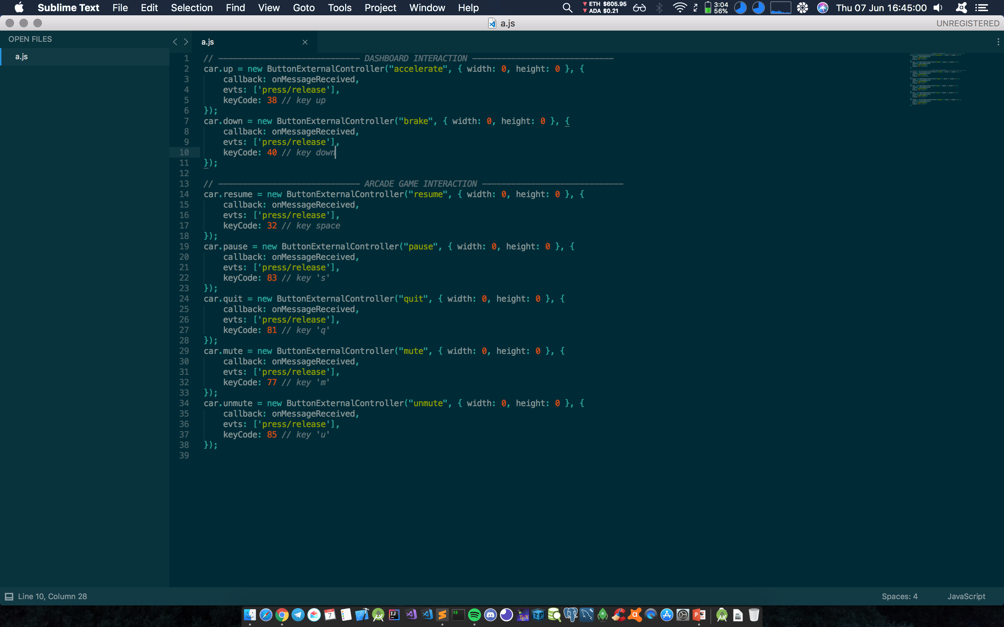
José Carlos Brandão (a71223@alunos.uminho.pt)
MSc Pre-dissertation in Computer Science PVSio-web
Interactions PVS/JS
A1
Index.js (Demo 1)
Create all interactions/ buttons whose specification is available at main.pvs file
Customization (Demo 2)
Notes:
Demo 2 – To allow users to write whatever they want interactions can not be placed at index.js because ButtonExternalController, which is an extension of Button Widget, ”steals” the keys used to capture press/release events for each declared button

Slide 16
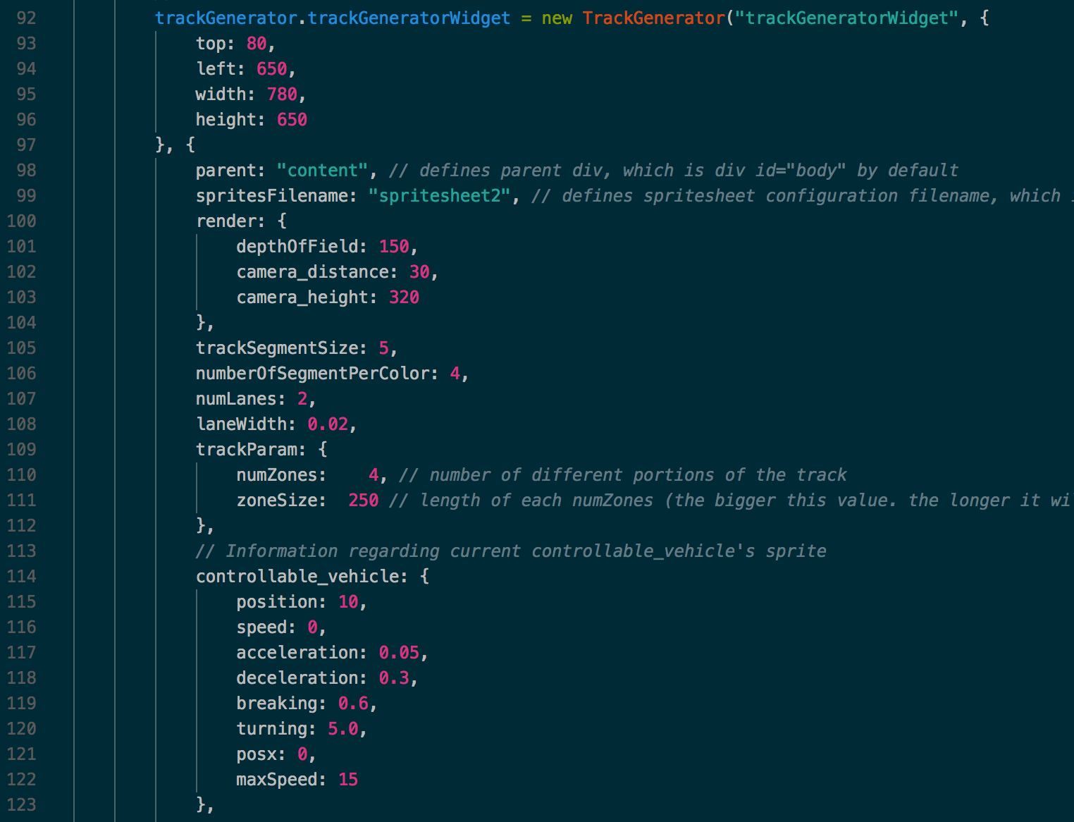
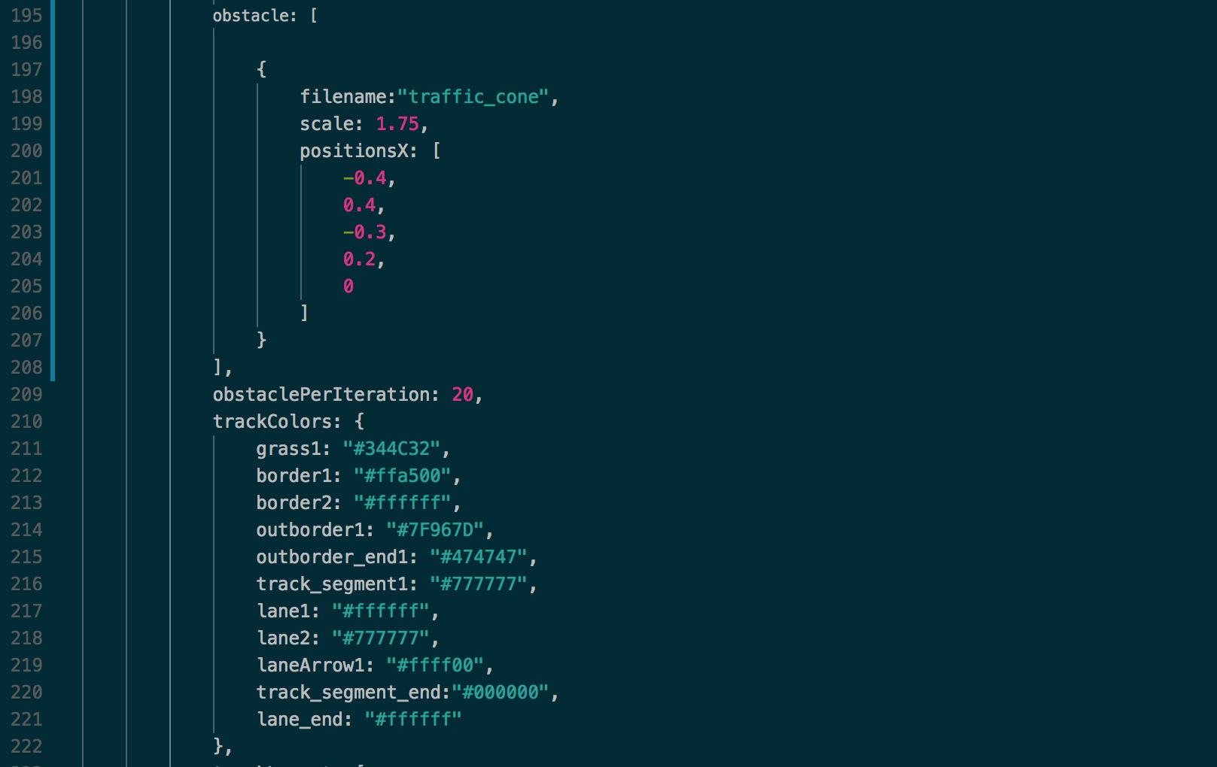
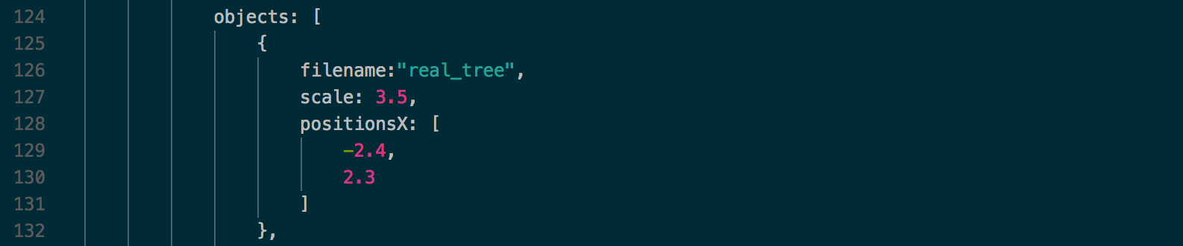
José Carlos Brandão (a71223@alunos.uminho.pt)
MSc Pre-dissertation in Computer Science PVSio-web
TrackGenerator Optional Fields I
A2

Slide 17
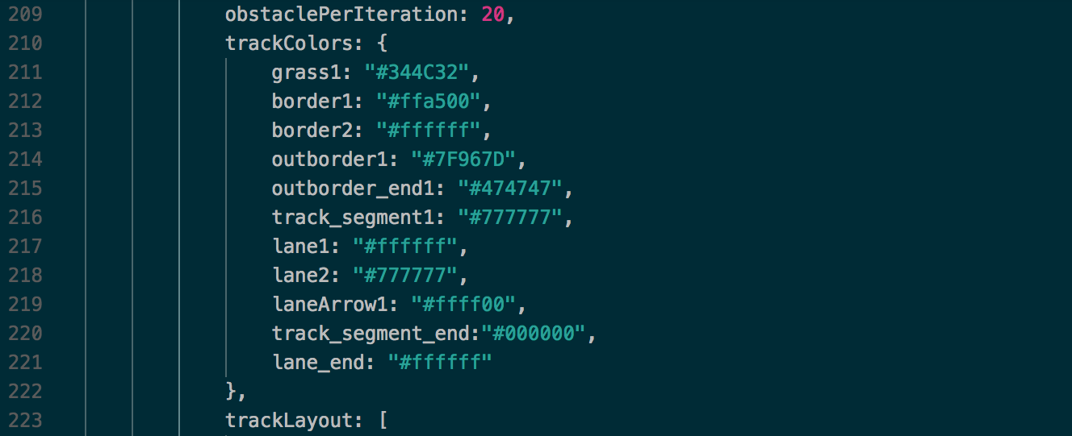
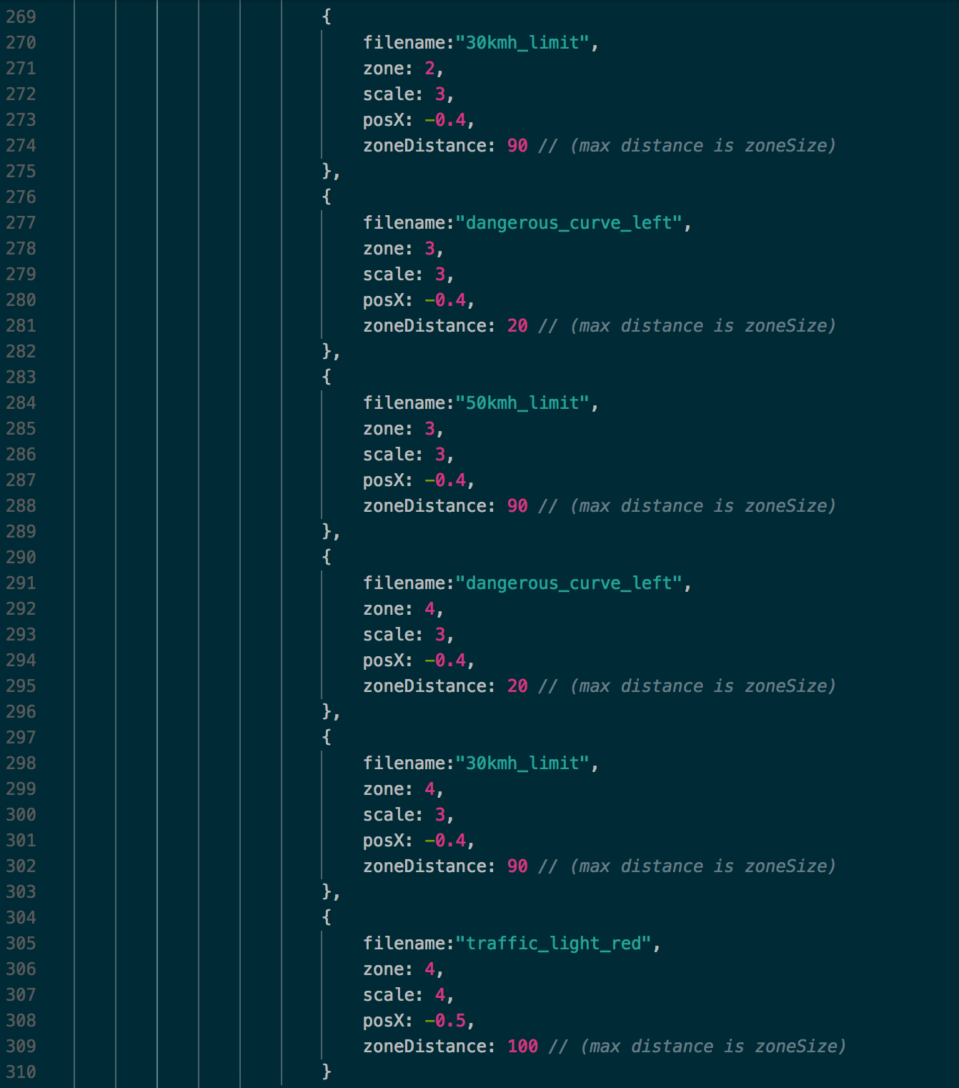
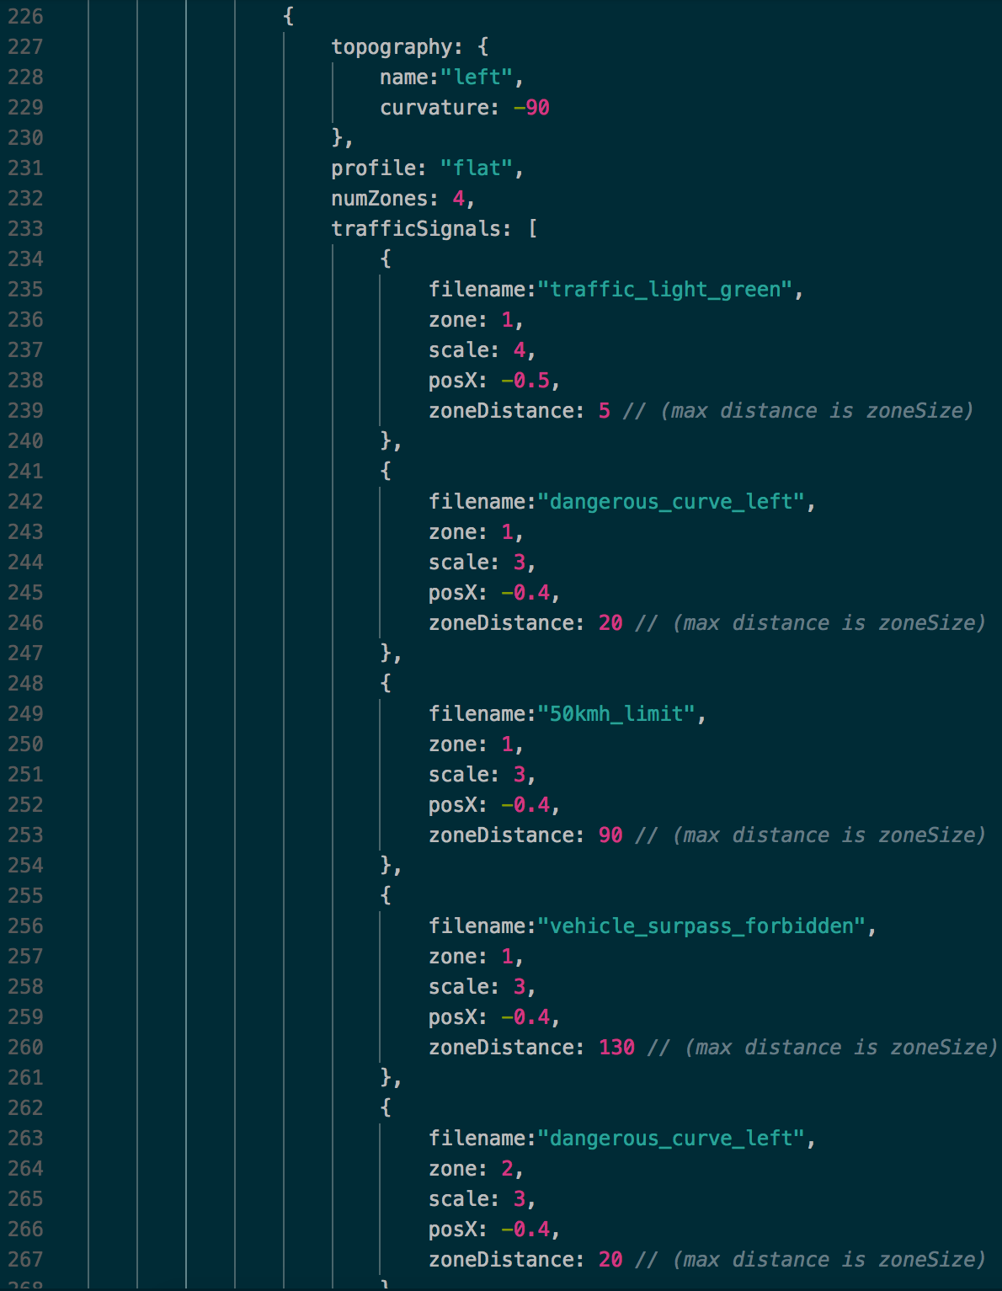
José Carlos Brandão (a71223@alunos.uminho.pt)
MSc Pre-dissertation in Computer Science PVSio-web
TrackGenerator Optional Fields II
A2

Slide 18
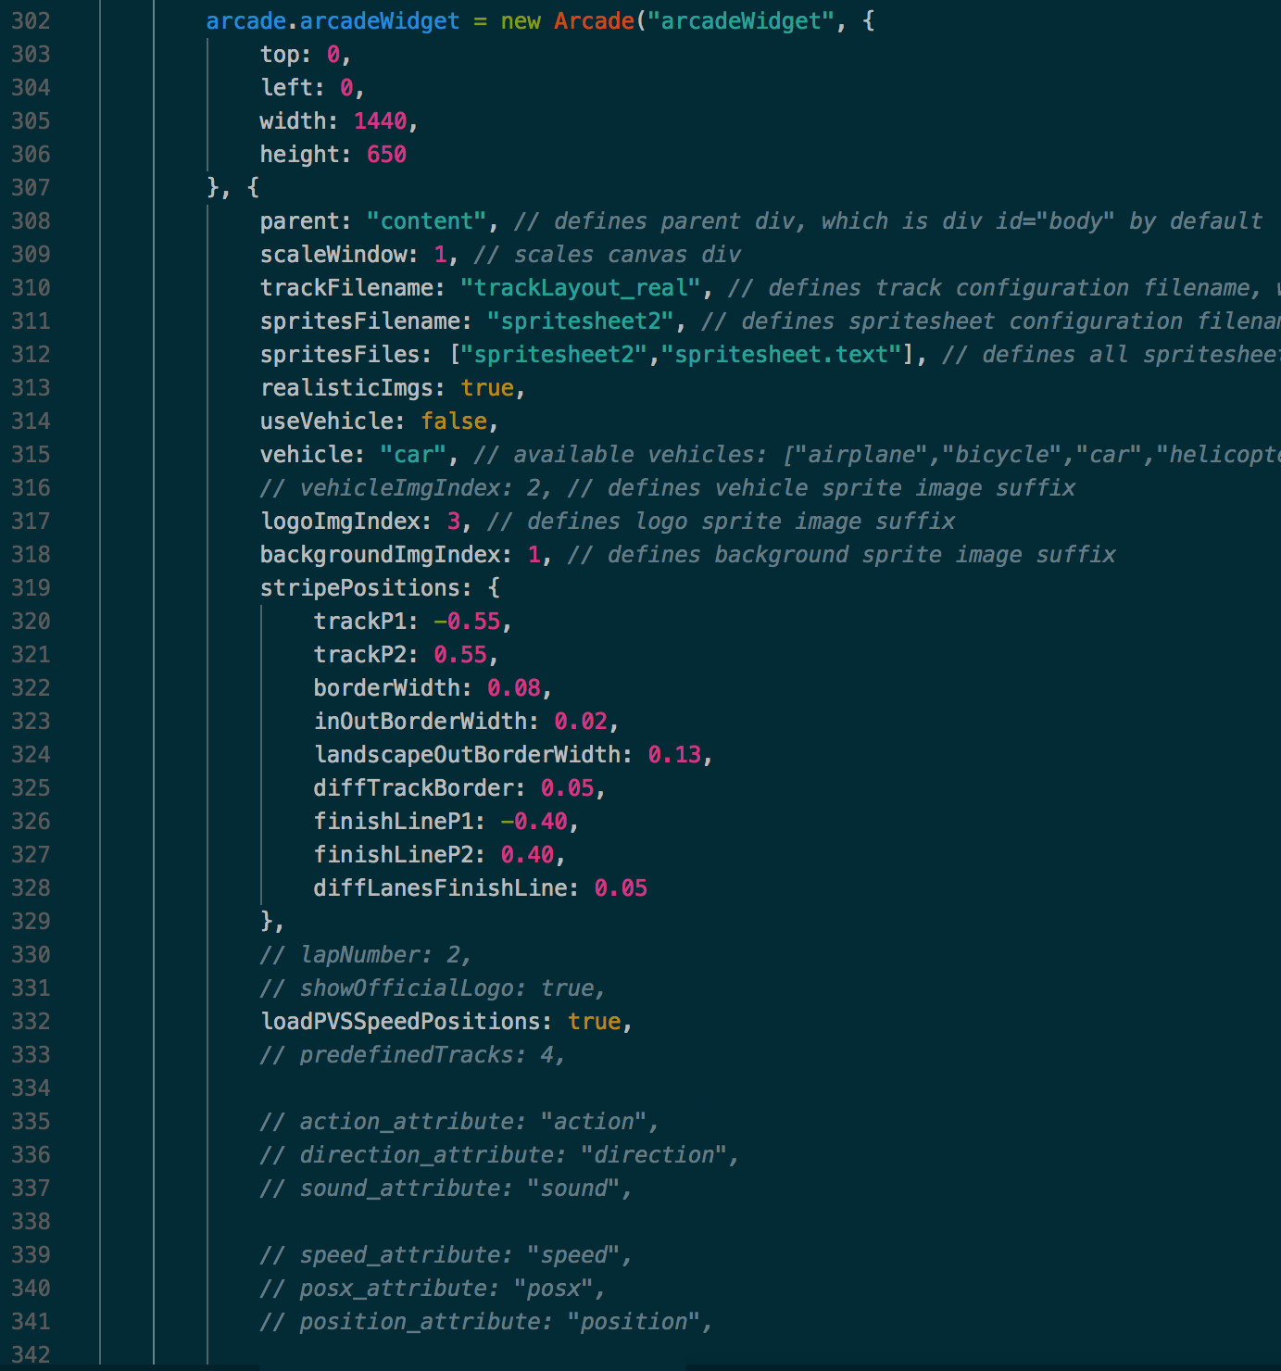
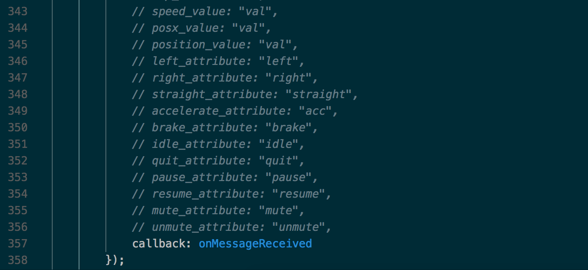
José Carlos Brandão (a71223@alunos.uminho.pt)
MSc Pre-dissertation in Computer Science PVSio-web
Arcade Optional Fields I
A3

Slide 19
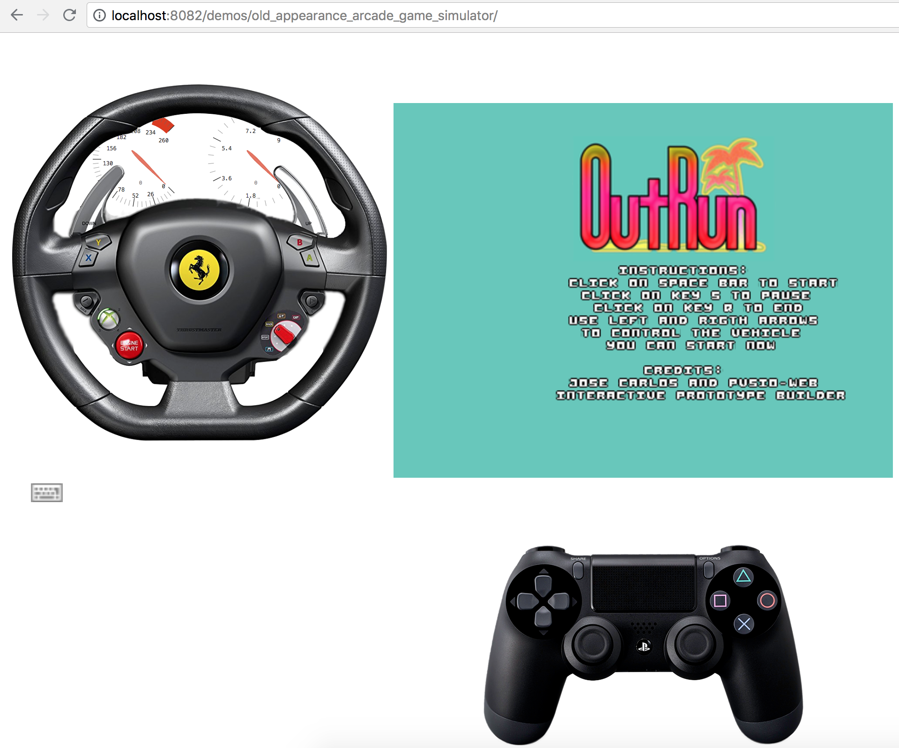
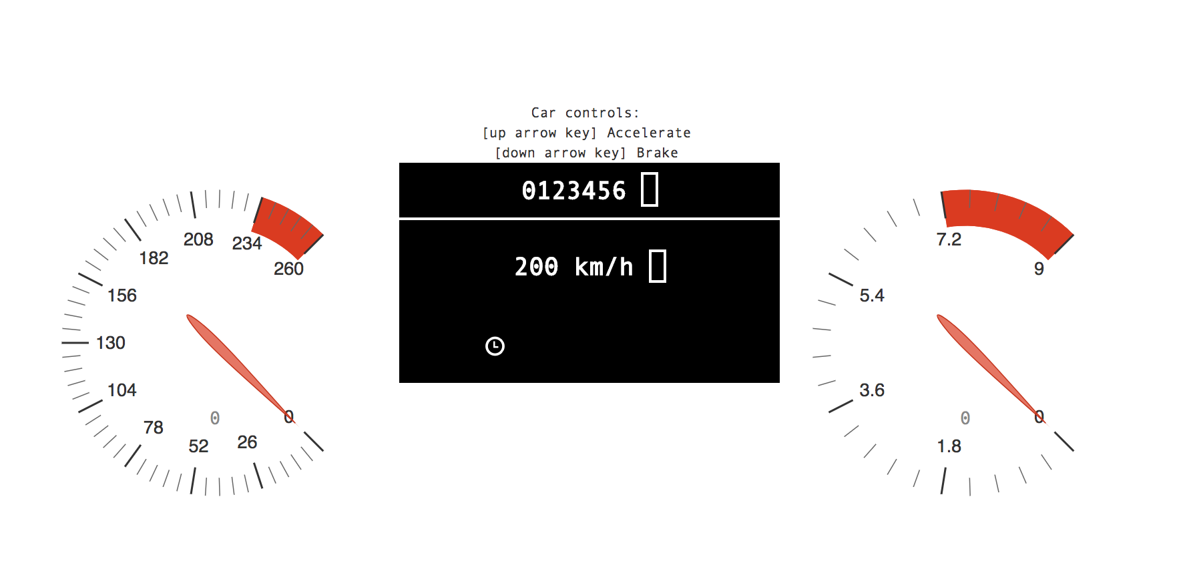
José Carlos Brandão (a71223@alunos.uminho.pt)
MSc Pre-dissertation in Computer Science PVSio-web
Widgets within PVSio-web
15
Initial Demo
vs
Demo 1
(More Conscious User)

Slide 20
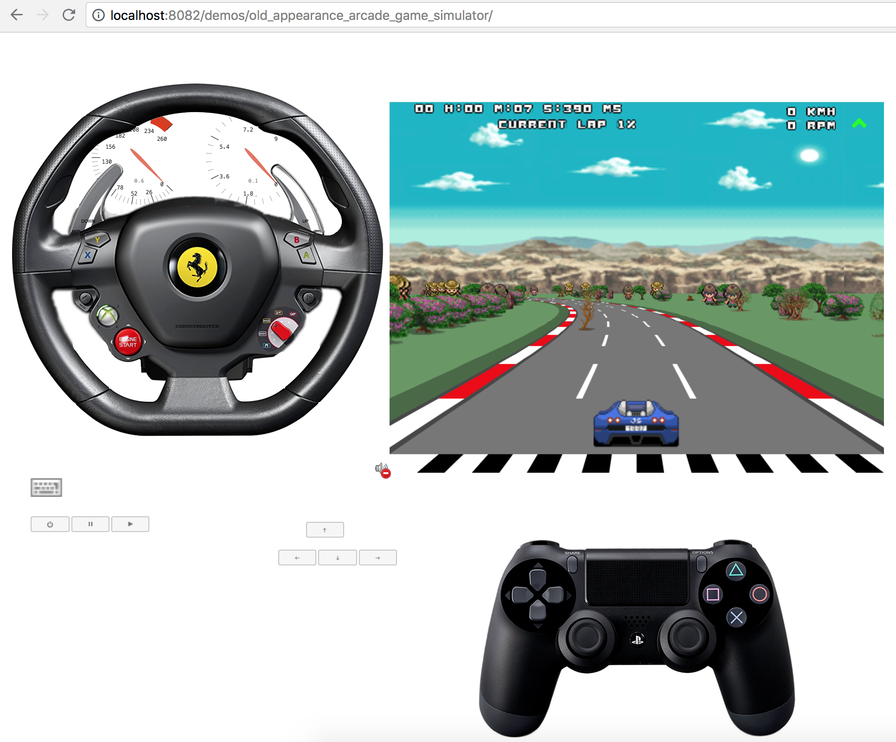
José Carlos Brandão (a71223@alunos.uminho.pt)
MSc Pre-dissertation in Computer Science PVSio-web
Widgets within PVSio-web
15
Initial Demo
vs
Demo 1
(More Conscious User)

Slide 21
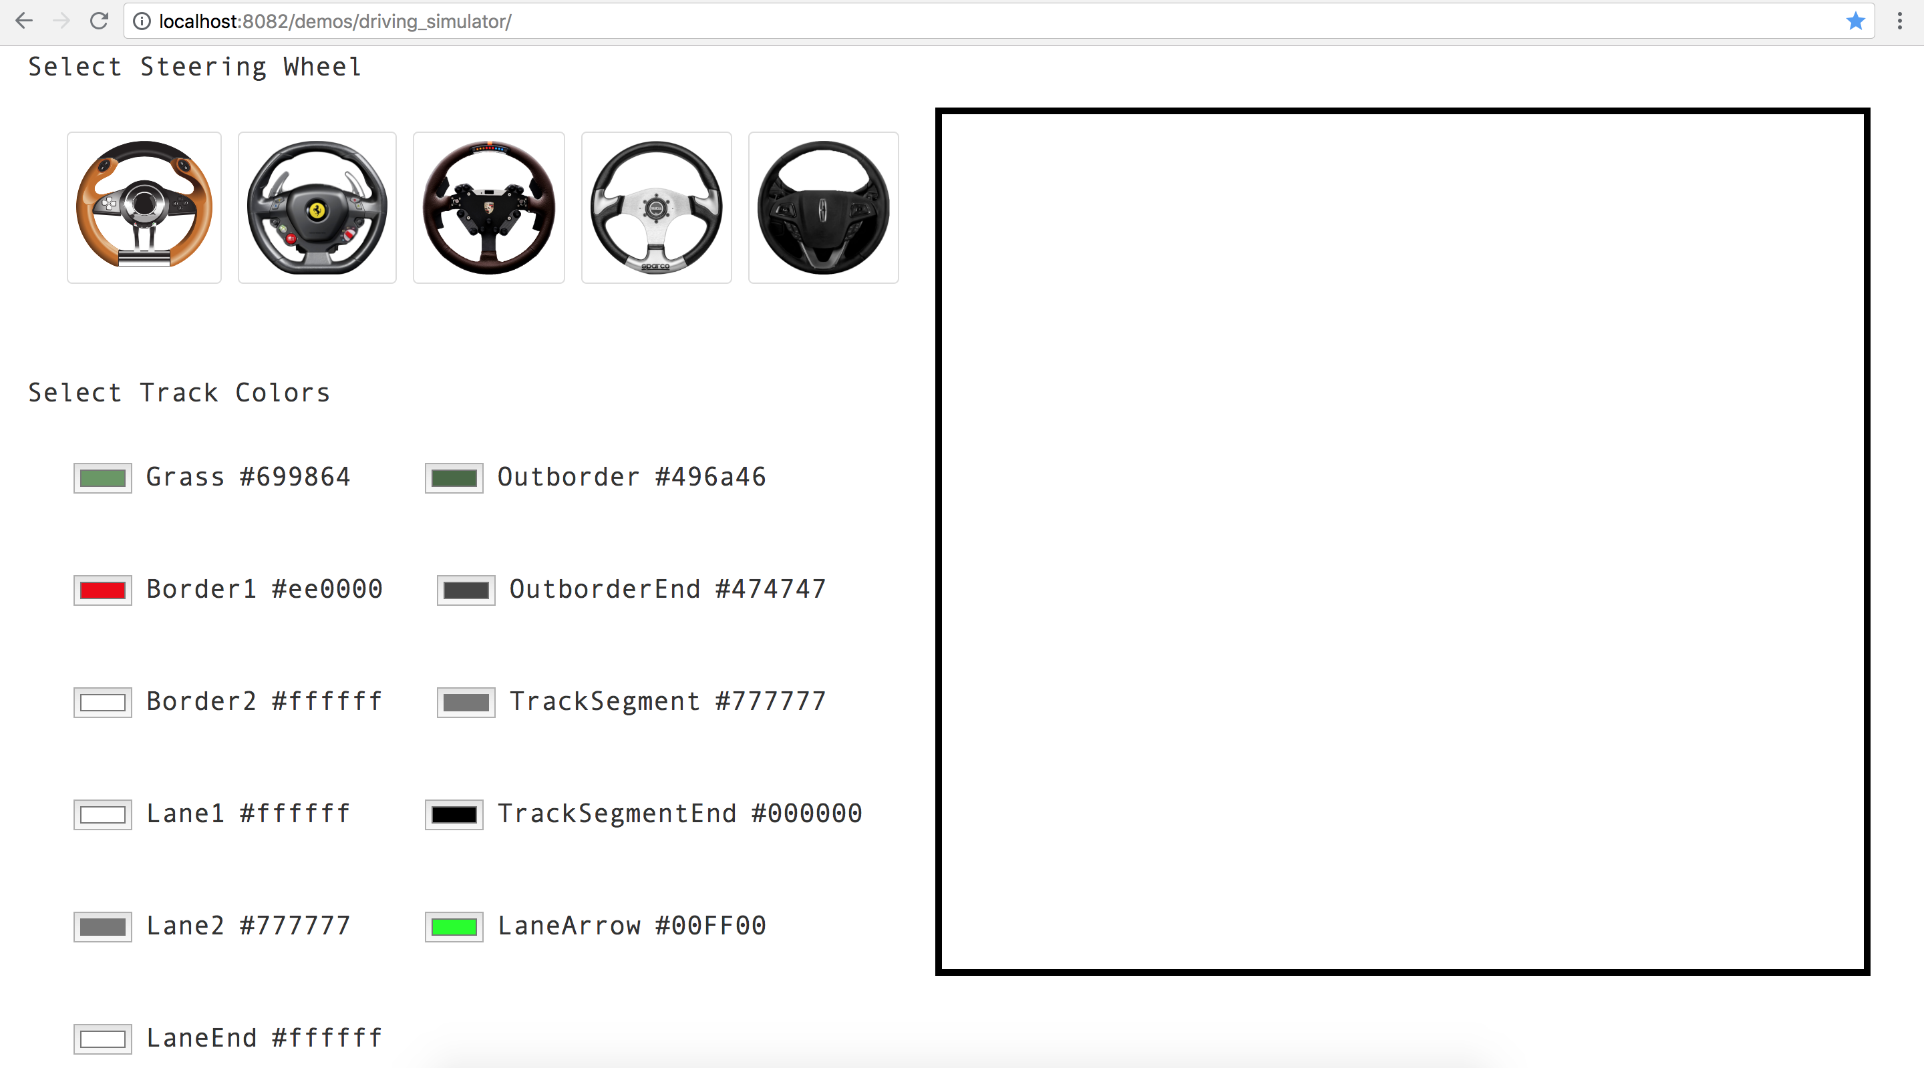
José Carlos Brandão (a71223@alunos.uminho.pt)
MSc Pre-dissertation in Computer Science PVSio-web
Widgets within PVSio-web
16
Demo 2
(Less Conscious User)
Steps 1-2

Slide 22
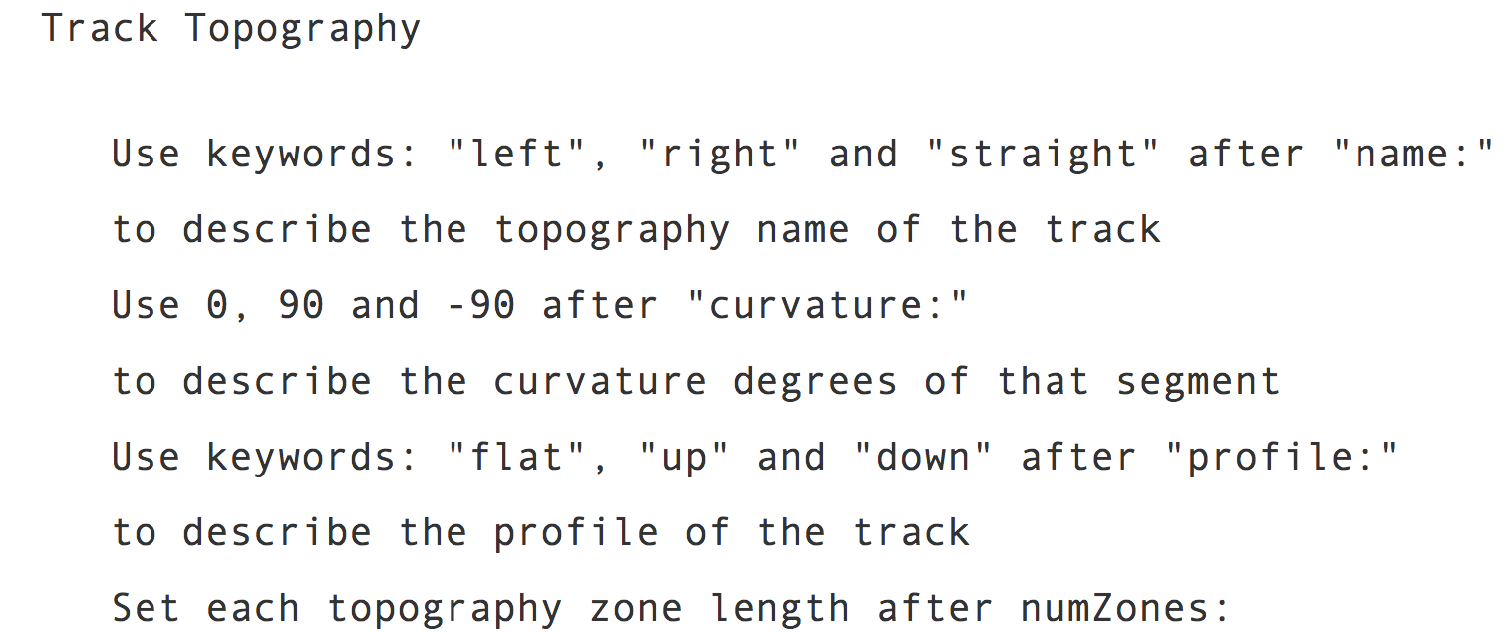
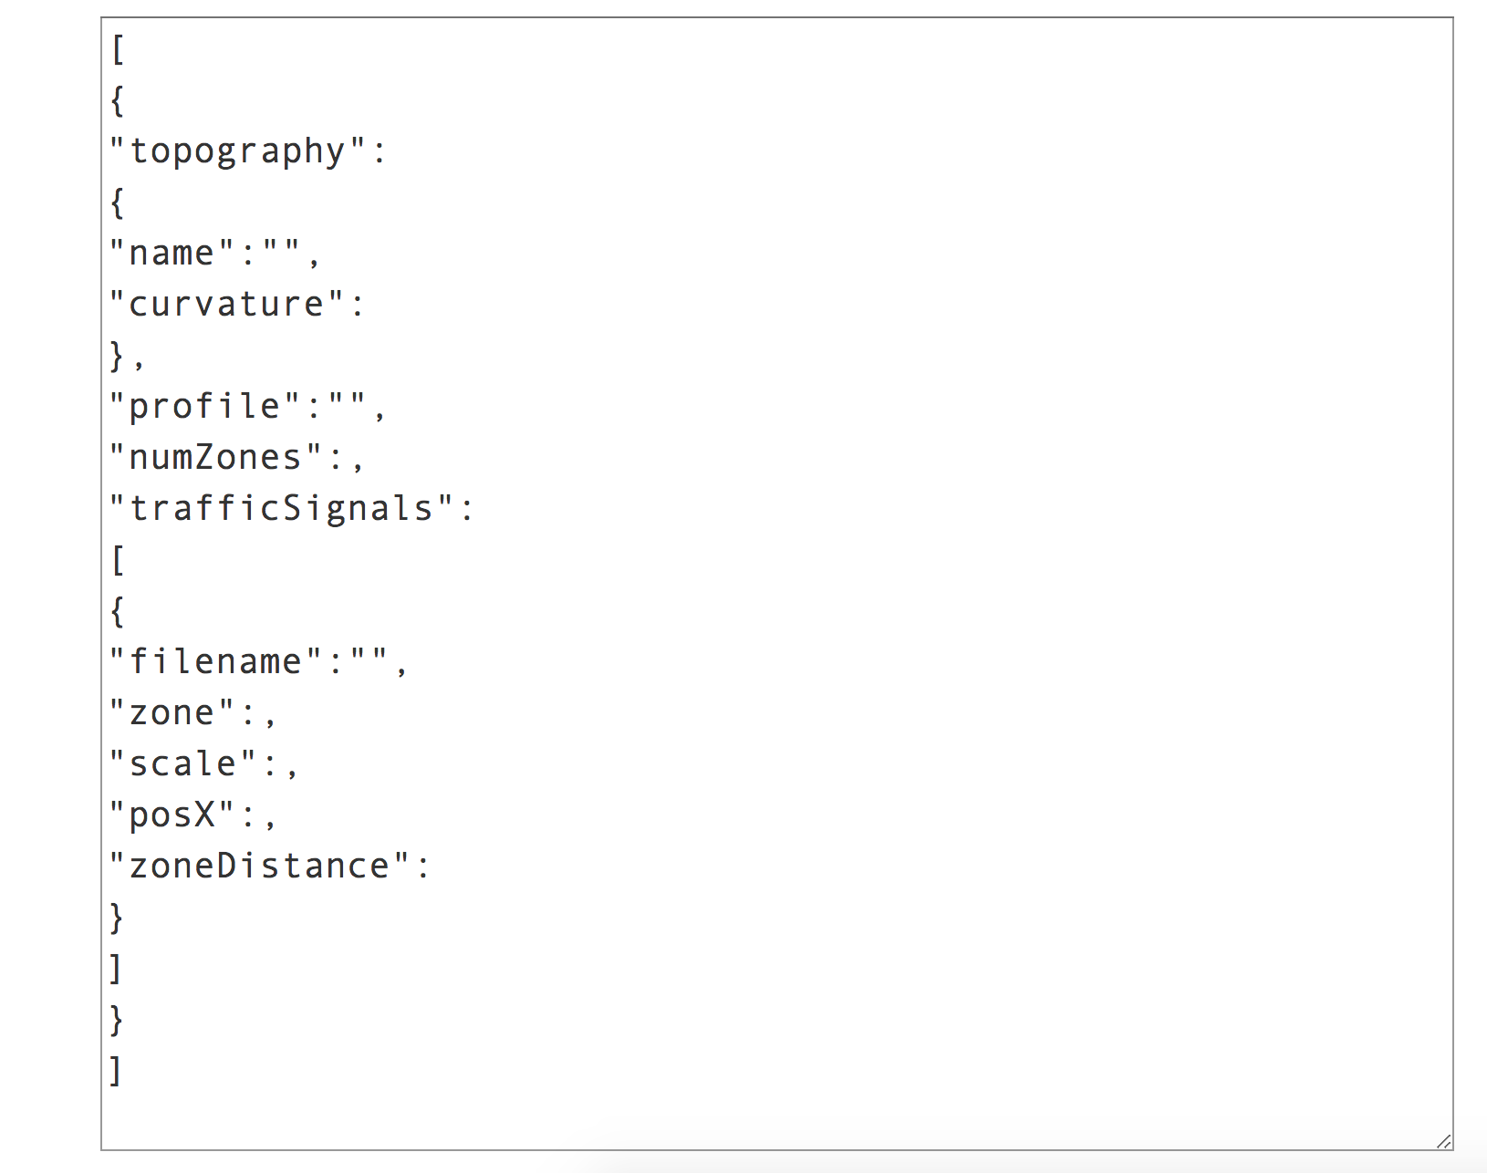
José Carlos Brandão (a71223@alunos.uminho.pt)
MSc Pre-dissertation in Computer Science PVSio-web
Widgets within PVSio-web
17
Demo 2
(Less Conscious User)
Steps 3

Slide 23
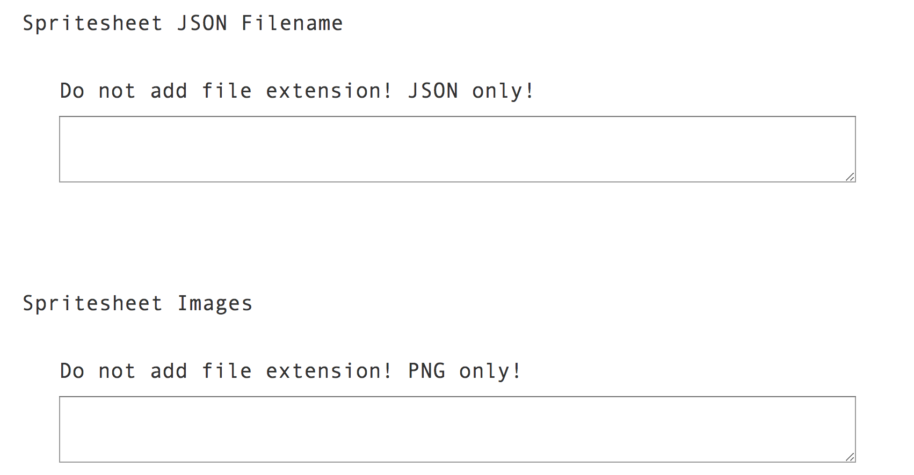
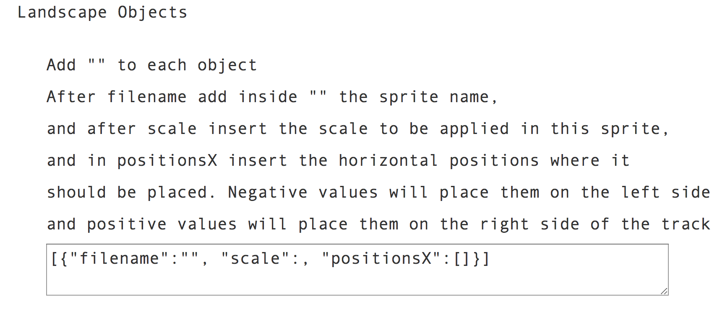
José Carlos Brandão (a71223@alunos.uminho.pt)
MSc Pre-dissertation in Computer Science PVSio-web
Widgets within PVSio-web
18
Demo 2
(Less Conscious User)
Steps 4-5-6

Slide 24
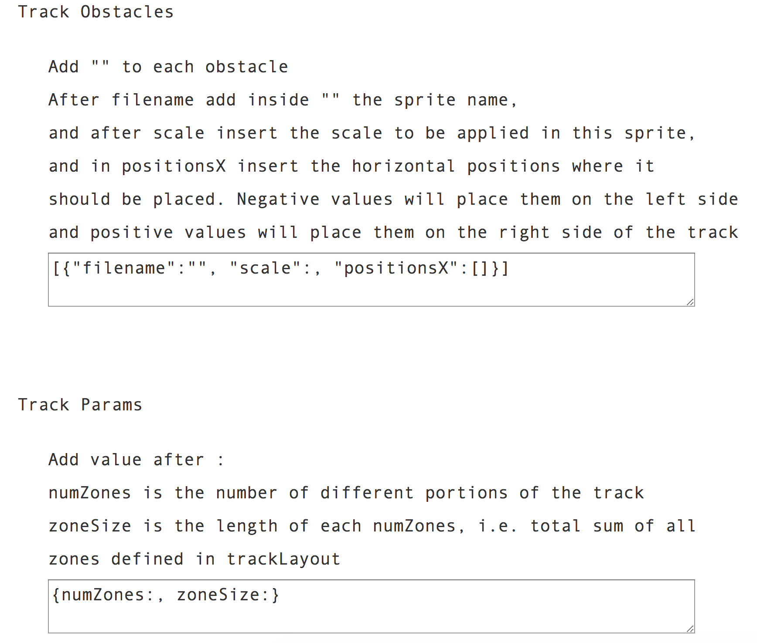
José Carlos Brandão (a71223@alunos.uminho.pt)
MSc Pre-dissertation in Computer Science PVSio-web
Widgets within PVSio-web
19
Demo 2
(Less Conscious User)
Steps 7-8

Slide 25
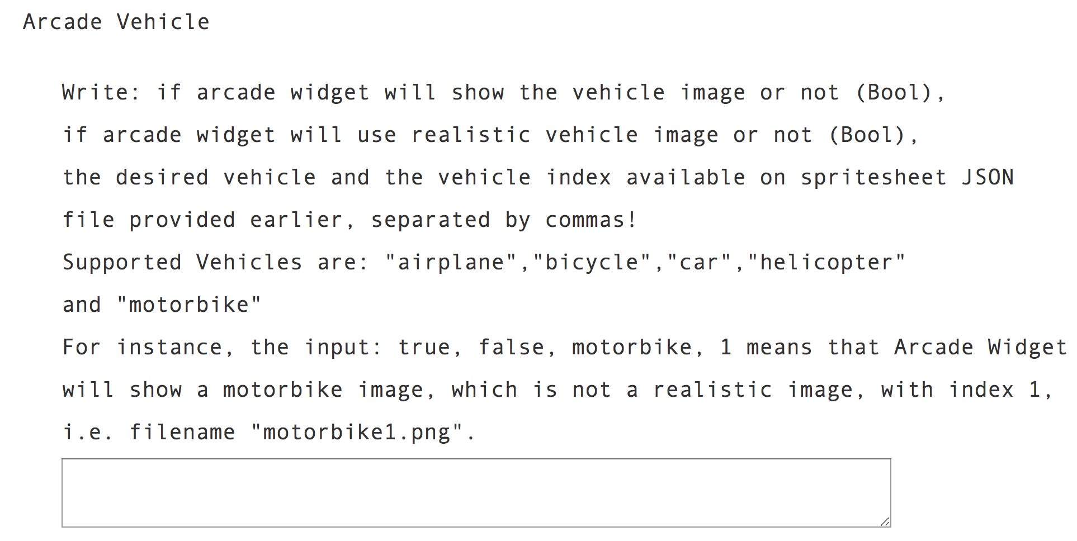
José Carlos Brandão (a71223@alunos.uminho.pt)
MSc Pre-dissertation in Computer Science PVSio-web
Widgets within PVSio-web
20
Demo 2
(Less Conscious User)
Step 9

Slide 26
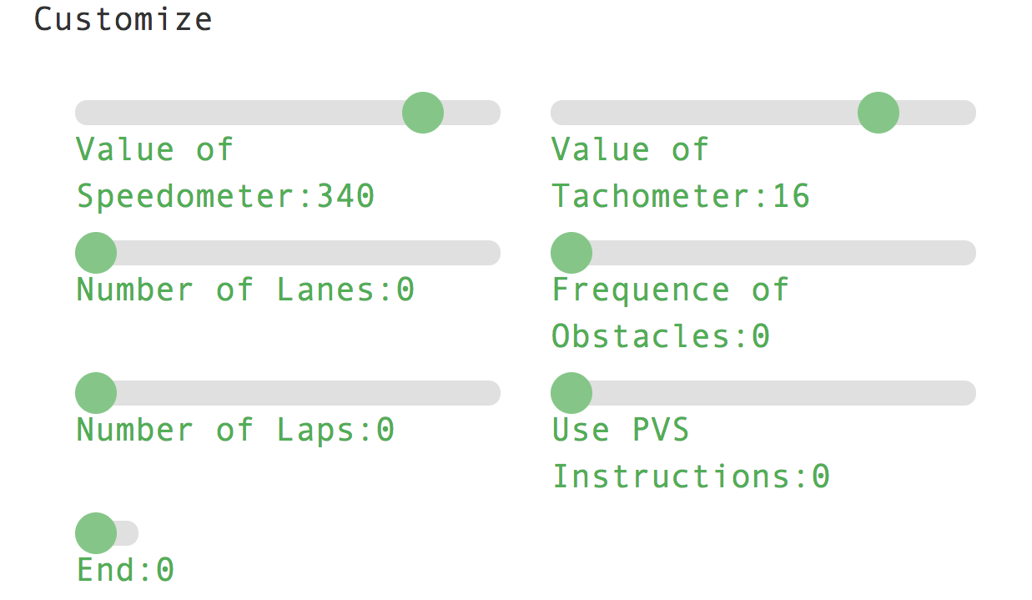
José Carlos Brandão (a71223@alunos.uminho.pt)
MSc Pre-dissertation in Computer Science PVSio-web
Widgets within PVSio-web
21
Demo 2
(Less Conscious User)
Steps 10-11-12
Step 13 (Final) Customization Widget

Slide 27
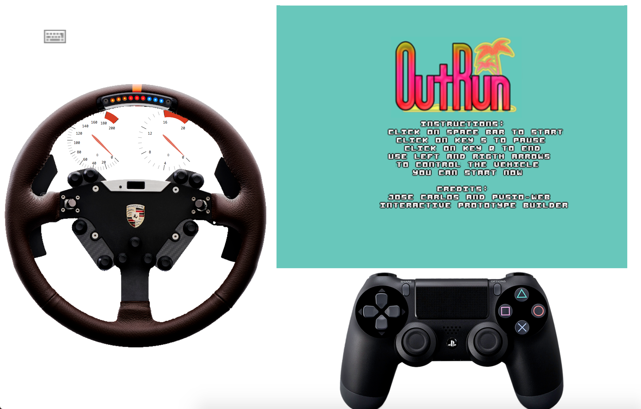
José Carlos Brandão (a71223@alunos.uminho.pt)
MSc Pre-dissertation in Computer Science PVSio-web
Widgets within PVSio-web
22
Demo 2 – After Configurations
(Less Conscious User)

Slide 28
José Carlos Brandão (a71223@alunos.uminho.pt)
MSc Pre-dissertation in Computer Science PVSio-web
Widgets within PVSio-web
13
Demo 2 – After Configurations
(Less Conscious User)

Slide 29
José Carlos Brandão (a71223@alunos.uminho.pt)
MSc Pre-dissertation in Computer Science PVSio-web
2D Arcade Racing Demos in Progress
23
Simulator Final Version
(More Conscious User – Fill all Optional Fields
on index.js)
Available at: https://github.com/zecarlos94/pvsio-web/tree/gamingDev/examples/demos/old_appearance_arcade_game_simulator
Simulator Final Version
(Less Conscious User – Fill all Inputs)
Available at: https://github.com/zecarlos94/pvsio-web/tree/gamingDev/examples/demos/driving_simulator
Based on Demos: Outrun (https://codeincomplete.com/games/racer/v4-final/) and RacerJS (https://github.com/onaluf/RacerJS)

Slide 30
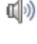
José Carlos Brandão (a71223@alunos.uminho.pt)
MSc Pre-dissertation in Computer Science PVSio-web
2D Arcade Racing Demos in Progress
24
Final Version
Based on Demos: Outrun (https://codeincomplete.com/games/racer/v4-final/) and RacerJS (https://github.com/onaluf/RacerJS)

Slide 31
José Carlos Brandão (a71223@alunos.uminho.pt)
MSc Pre-dissertation in Computer Science PVSio-web
2D Arcade Racing Demos in Progress
25
Tutorial
Available at: https://github.com/zecarlos94/pvsio-web/blob/gamingDev/src/client/app/widgets/car/car_tutorials/index.html
All Documentation
Available at: https://github.com/zecarlos94/pvsio-web/blob/gamingDev/src/client/app/widgets/car/car_docs/index.html

Slide 32
END
MSc Pre-dissertation Workshop
2D Arcade Racing Game
Jul 21st, 2018
Advisor: José Creissac Campos
Co-Advisor: Paolo Masci

Slide 33
PVSio-web
Design and development of an arcade simulation environment for PVSio-web
MSc in Computer Science
José Carlos Brandão (a71223)
Escola de Engenharia
Departamento de Informática
Universidade do Minho

